Slide 1
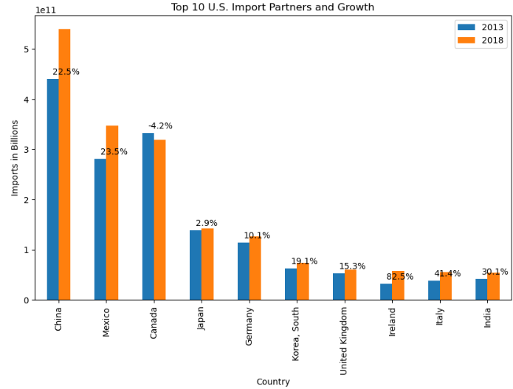

Slide 2
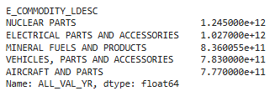
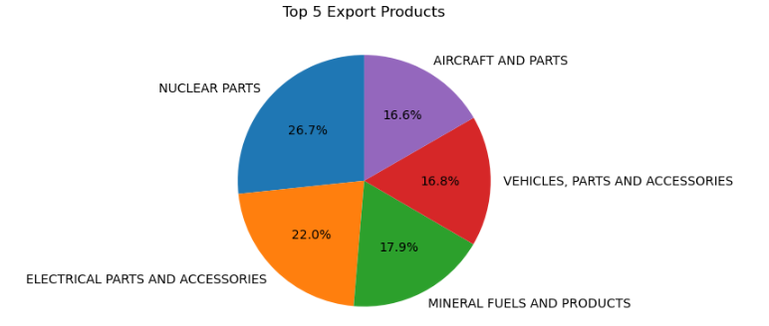
TOP 5 EXPORT PRODUCTS (2013-2018)

Slide 3
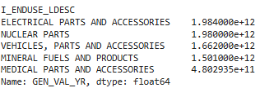
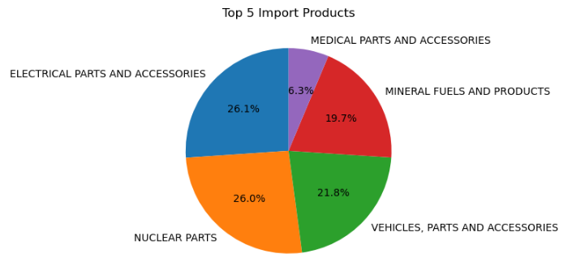
TOP 5 IMPORT PRODUCTS (2013-2018)

Slide 4
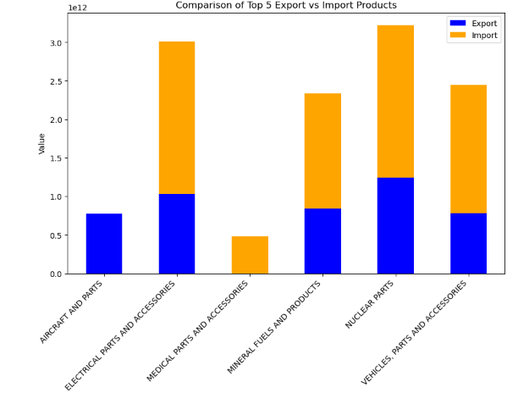
TOP 5 EXPORT PRODUCTS VS IMPORT PRODUCTS

